Slide 1

VIRTUAL MEMORY PAGE REPLACEMENT Visualizer
COURSE : OPERATING SYSTEMS AND SYSTEMS PROGRAMMING
COURSE CODE: 25SC2104E
SECTION: 4
Branch: CSE
GUIDED BY: E. SOUMYA (ASSISTANT PROFESSOR)
2520030157 - SAI SURENDRANATH PENDYALA
252003030195 - ADA ROHAN
2520030291 - Medikonda ram ratan
2026-2027

Slide 2
CONTENTS
Abstract
Introduction
Objectives
Problem Statement
Existing Solution
Proposed Solution
Technologies Used
System Design
Flowchart
Implementation Approach
Web Application Screenshot
Input Screenshots
Output Screenshots
Step By Step Simulation
Impact
Conclusion
Future Scope

Slide 3
abstract
The Virtual Memory Page Replacement Visualizer is a web-based application designed to demonstrate and compare three page replacement algorithms used in operating systems: First In, First Out (FIFO), Least Recently Used (LRU), and Optimal Page Replacement. When physical memory becomes full and a new page needs to be loaded, the operating system must select a page to replace. The proposed system simulates this process using a user- defined page reference string and a specified number of memory frames. It visually displays the contents of memory frames after each page request and identifies page hits and page faults. The system calculates the total number of page faults generated by each algorithm and presents a comparative analysis using tables and graphical representations. This helps users understand how different page replacement strategies operate and how their performance varies with different input sequences. The application can be developed using HTML, CSS, and JavaScript, providing an interactive and user-friendly interface for learning operating system memory management concepts. The proposed visualizer serves as an educational tool for students to understand virtual memory, page replacement techniques, and the importance of reducing page faults to improve memory management efficiency.

Slide 4
Introduction
Virtual memory is an important concept in operating systems that allows programs to execute efficiently by using secondary storage as an extension of physical memory. When a required page is not available in RAM, a page fault occurs, and the operating system must load the required page into memory. If all memory frames are occupied, a page replacement algorithm is used to select a page for removal. FIFO (First In, First Out), LRU (Least Recently Used), and Optimal Page Replacement are three commonly studied algorithms for this purpose. Understanding their working process and comparing their performance can be difficult through theoretical explanations alone. The Virtual Memory Page Replacement Visualizer provides an interactive graphical representation of these algorithms, showing memory frame changes, page hits, page faults, and total page fault counts. It helps students understand memory management concepts and analyze the performance of different page replacement strategies using the same input sequence.

Slide 5
Problem statement
Understanding page replacement algorithms in operating systems can be challenging for students because the process of managing memory frames and replacing pages is difficult to visualize through theoretical explanations alone. When physical memory becomes full, the operating system must select a page to remove before loading a new page. Different algorithms, such as FIFO, LRU, and Optimal Page Replacement, make these decisions using different strategies, resulting in different numbers of page faults. Therefore, there is a need for an interactive visualizer that demonstrates the step-by-step working of these algorithms, displays page hits and page faults, and compares their performance using the same page reference string and number of memory frames. The proposed system aims to simplify the learning process and help users understand the effectiveness of different page replacement techniques.

Slide 6
OBJECTIVES
The main objective of the Virtual Memory Page Replacement Visualizer is to develop a user-friendly web application that demonstrates the working of FIFO, LRU, and Optimal Page Replacement algorithms. The system allows users to enter a page reference string and specify the number of memory frames. It visually displays the memory frame contents after each page request and clearly identifies page hits and page faults. The application calculates the total number of page faults generated by each algorithm and compares their performance using tables and graphical representations. It aims to improve students' understanding of virtual memory, page replacement techniques, and operating system memory management through an interactive and easy-to-understand learning experience.

Slide 7
EXISTING SOLUTION
Traditional methods of learning page replacement algorithms mainly rely on textbooks, classroom explanations, and static examples. These methods explain the working principles of FIFO, LRU, and Optimal Page Replacement but may not provide an interactive representation of memory frame changes for different page reference strings. Some existing simulators demonstrate individual algorithms or require users to calculate page faults manually. Comparing multiple algorithms can therefore be time-consuming and difficult for beginners. These limitations highlight the need for a user-friendly visual tool that demonstrates page replacement step by step and compares the performance of all three algorithms using the same input.

Slide 8
PROPOSED SOLUTION
The proposed Virtual Memory Page Replacement Visualizer is an interactive web application designed to simplify the understanding of page replacement algorithms. The system allows users to enter a page reference string and specify the number of memory frames. It simulates FIFO, LRU, and Optimal Page Replacement algorithms and displays the changes in memory frames step by step. Page hits and page faults are highlighted visually to help users understand how each algorithm handles page requests. The application calculates the total page faults for each algorithm and presents a comparative analysis using tables and graphical representations. By providing a simple interface and real-time visual feedback during simulation, the proposed system helps students understand memory management concepts and evaluate the performance of different page replacement strategies.

Slide 9
Technologies used
The Virtual Memory Page Replacement Visualizer is developed using HTML, CSS, and JavaScript. HTML is used to structure the web application, including input fields, buttons, memory frames, and result sections. CSS is used to design an attractive, responsive, and user-friendly interface with visual indicators for page hits and page faults. JavaScript implements the FIFO, LRU, and Optimal Page Replacement algorithms, processes the user-provided page reference string, updates memory frame contents, and calculates the total number of page faults. Tables and graphical representations are used to compare the performance of the three algorithms. These technologies work together to provide an interactive and efficient platform for understanding virtual memory and page replacement techniques.

Slide 10
SYSTEM DESIGN
The system design of the Virtual Memory Page Replacement Visualizer consists of three main components: the user interface, the page replacement algorithm module, and the results visualization module. The user interface allows users to enter a page reference string and specify the number of memory frames. The algorithm module processes the input using FIFO, LRU, and Optimal Page Replacement techniques and determines which pages should be loaded into or removed from memory. During the simulation, the system records memory frame changes and identifies page hits and page faults. The results visualization module displays the step-by-step simulation, calculates the total page faults for each algorithm, and presents a comparative analysis using tables and charts. These components work together to provide an interactive and user-friendly platform for understanding and comparing page replacement algorithms.

Slide 11
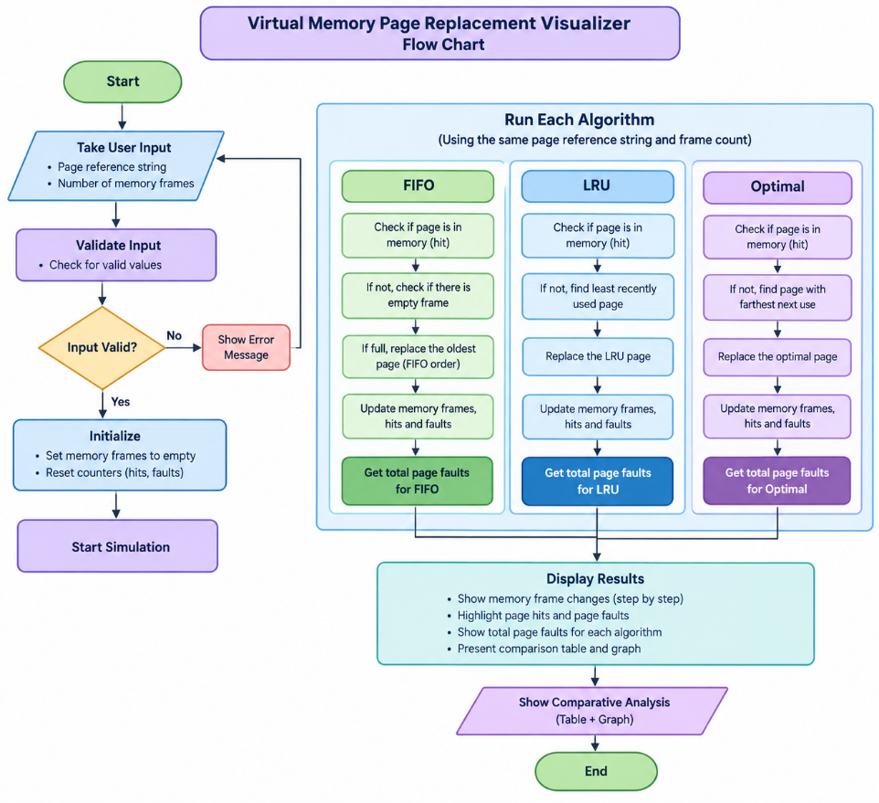
FLOWCHART

Slide 12
Implementation approach
The implementation of the Virtual Memory Page Replacement Visualizer begins with designing a user-friendly web interface using HTML and CSS. Users can enter a page reference string and specify the number of memory frames required for the simulation. JavaScript is used to implement the FIFO, LRU, and Optimal Page Replacement algorithms. The system processes each page request, checks whether the page is already present in memory, and identifies page hits and page faults. When all memory frames are occupied, the appropriate algorithm selects a page for replacement. The application updates the memory frame contents after each request and calculates the total number of page faults for each algorithm. Finally, the results are displayed using step-by-step visualizations, comparison tables, and graphical representations. The system is tested with different input sequences and frame counts to verify the correctness of the algorithms and ensure reliable performance.

Slide 13
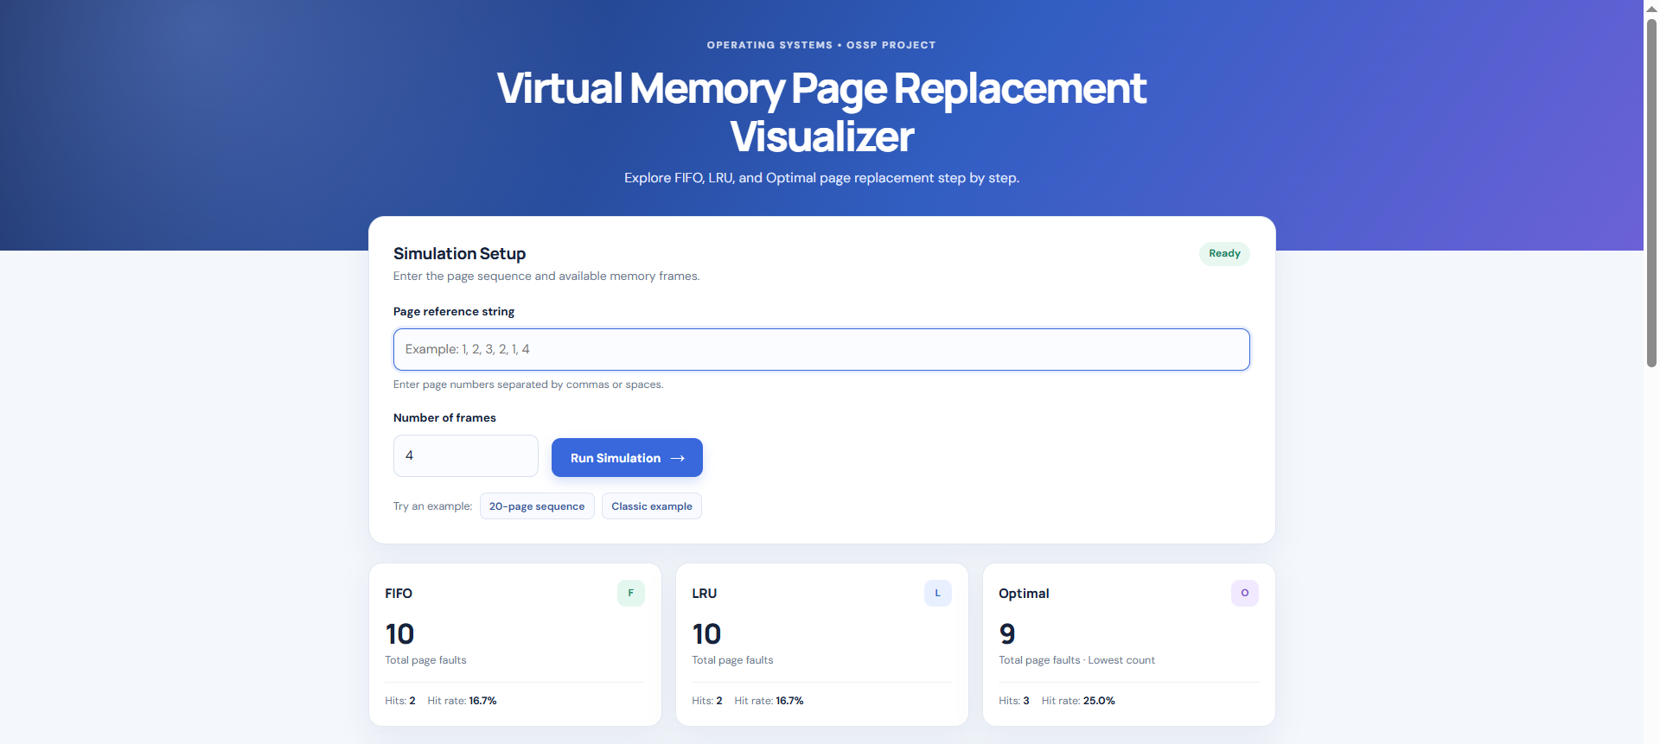
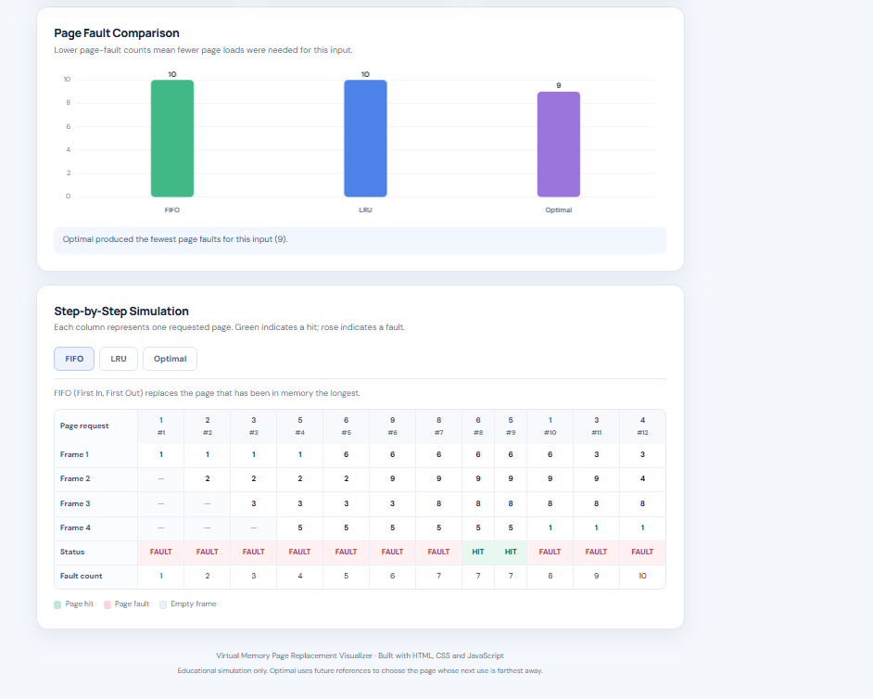
Web Application Screenshot

Slide 14
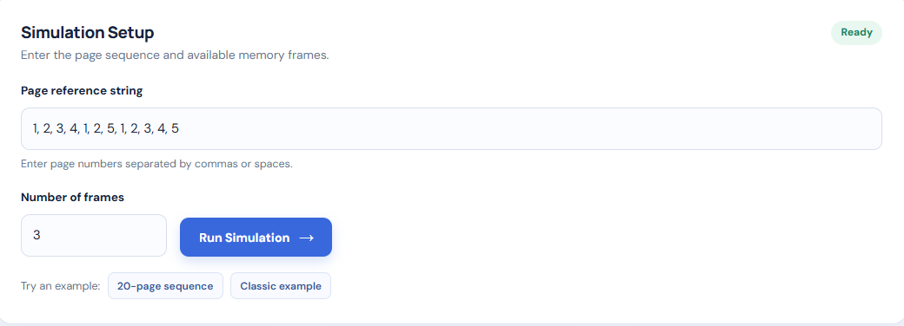
INPUT SCREENSHOT

Slide 15
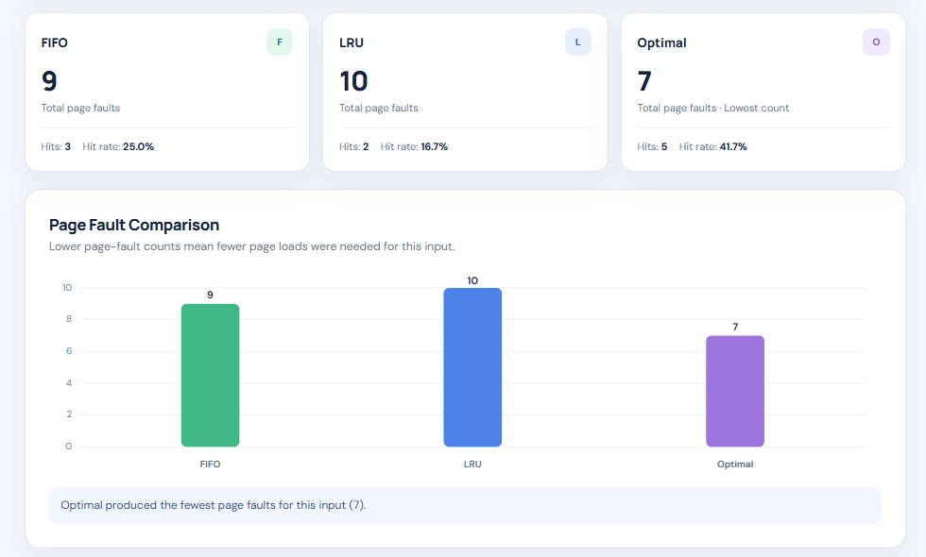
OUTPUT SCREENSHOT

Slide 16
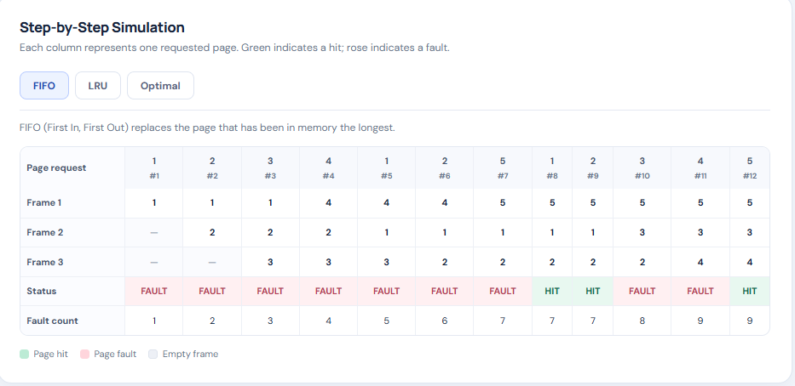
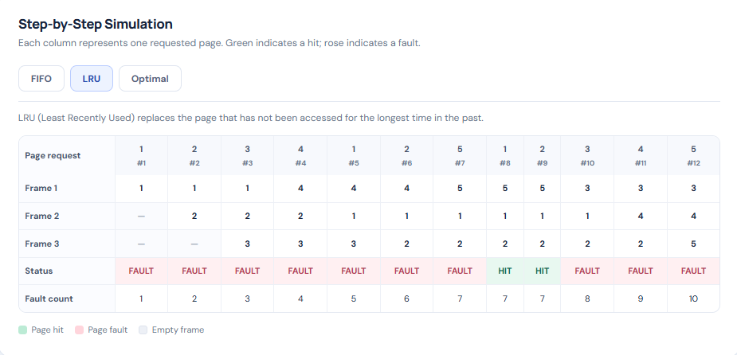
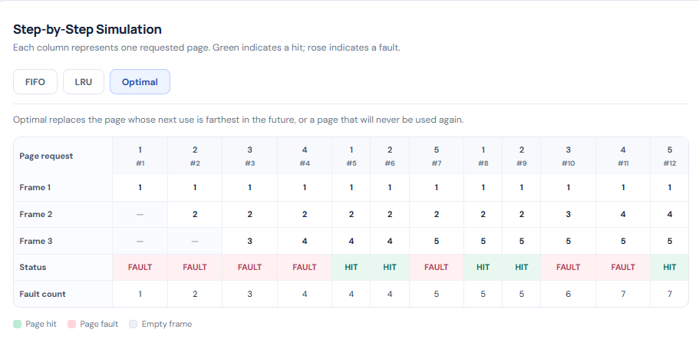
STEP BY STEP SIMULATION

Slide 17
Impact
The Virtual Memory Page Replacement Visualizer improves students' understanding of virtual memory and page replacement algorithms through interactive visual demonstrations. It helps learners understand how FIFO, LRU, and Optimal algorithms manage memory frames and handle page faults. By comparing the number of page faults generated by each algorithm, students can easily identify differences in their performance. The visual representation of page hits, page faults, and memory frame changes makes complex operating system concepts easier to learn and remember. This application also supports practical learning, encourages algorithmic thinking, and helps students develop a better understanding of efficient memory management in operating systems.

Slide 18
CONCLUSION
The Virtual Memory Page Replacement Visualizer provides an interactive platform for understanding and comparing FIFO, LRU, and Optimal Page Replacement algorithms. It demonstrates memory frame changes, identifies page hits and page faults, and calculates the total page faults generated by each algorithm. The comparative analysis helps users understand how different page replacement strategies perform for the same page reference string. Developed using HTML, CSS, and JavaScript, the application simplifies operating system memory management concepts through clear visual representations. Overall, the project serves as an effective educational tool for students to learn and understand virtual memory and page replacement techniques.

Slide 19
Future scope
The Virtual Memory Page Replacement Visualizer can be enhanced by introducing step-by-step playback controls, animated page replacement, and additional page replacement algorithms such as LFU (Least Frequently Used). Future improvements may include downloadable simulation reports, interactive quizzes, and detailed performance statistics. The application can also be extended to support larger page reference strings, customizable visualization themes, and mobile-friendly features. These enhancements can make the system more interactive, accessible, and useful for students learning advanced operating system concepts.

Slide 20


